Slide 1
Testing in React Unit Test, Integration Test, E2E Test
Animated by :Taki Eddine RAHAL

Slide 2

I. Introduction II. Tools and Dependencies III. Unit Testing IV. Integration Testing V. End-to-End Testing
Plan

Slide 3
I. Introduction

Slide 4
Introduction
Importance of Testing
Test if everything works as expected.
Helps identify bugs in the early stages of the development cycle
It saves time and money during the later testing phases
Making corrections and changes in the code is quick : When you have tests, you can change stuff without worrying about breaking things. This means you can add new features or tidy up the code with less stress.

Slide 5
Introduction
Importance of Testing
It is easy to onboard new team members in the development as they can also understand the code base with less effort. Moreover, any damage to the code becomes less worrisome as it can be quickly identified.
Unit testing facilitates changes to the code by providing a way to quickly and easily verify that changes to the code do not break existing functionality
Tests can serve as a code documentation

Slide 6
Introduction
What Not to Test
Actual Implementation
=> dependencies, library, SDK …..

Slide 7
Introduction
What Not to Test
2. Third Party libraries
=> If you are using any third party libraries like Material UI, no need to test those – they should already be tried and tested.…..

Slide 8
Introduction
Test Structured
Any test in React, no matter how complicated, follows this structure
- Render the component
- Get an element from the component and simulate any user interactions
- Write an assertion.

Slide 9
Introduction
Testing Best Practices
Utilize the Arrange-Act-Assert (AAA) pattern: Given-When-Then
=> The AAA pattern is a fundamental principle in testing that helps maintain clarity and organization in your test cases. Arrange sets the test, Act performs the action or interaction, and Assert verifies the expected outcome.

Slide 10
Introduction
Testing Best Practices
Utilize the Arrange-Act-Assert (AAA) pattern: Given-When-Then
test(‘Example Component renders correctly’, () => { // Arrange (Given) const { getByText } = render(<ExampleComponent />); // Act (When) const element = getByText(‘Hello, World!’); // Assert (Then) expect(element).toBeInTheDocument(); });

Slide 11
Introduction
Testing Best Practices
2. Utilize the Test components in isolation
Testing individual components ensures thorough examination without interference from other parts, making debugging more accessible and faster.
test(‘Incorrect way of testing multiple components’, () => {
const { getByText } = render(<ParentComponent />);
const childElement = getByText(‘Child Component’);
expect(childElement).toBeInTheDocument();
});
=> Bad practice: testing multiple components together

Slide 12
Introduction
Testing Best Practices
3. Mock external dependencies
If your component relies on external dependencies, such as API calls or modules, it’s best to mock them during testing to isolate the component’s behaviour.

Slide 13
Introduction
Testing Best Practices
3. Mock external dependencies
Tools like Jest provide mocking capabilities to help you easily mock dependencies.
import axios from ‘axios’;
jest.mock(‘axios’);
test(‘Component fetches data from API correctly’, async () => {
axios.get.mockResolvedValue({ data: ‘mocked data’ });
const { getByText } = render(<DataFetchingComponent />);
await waitFor(() => {
expect(getByText(‘Data: mocked data’)).toBeInTheDocument();
});
});

Slide 14
Introduction
Testing Best Practices
3. Mock external dependencies
// Assuming App.js exports a class as default
import App from './App';
test('someMethod on App is called', () => {
// Create an instance of the App class
const appInstance = new App();
// Spy on the someMethod of the instance
const spy = jest.spyOn(appInstance, 'someMethod');
// Call the method on the instance
appInstance.someMethod();
// Assert that the spy was called
expect(spy).toHaveBeenCalled();
// Clean up the spy to avoid interference with other tests
spy.mockRestore();
});

Slide 15
Introduction
Unit Tests vs Integration Tests vs E2E Tests
BeforeAll
Kent C Dodds, a well-known software engineer, once said that what is important is the value that testing provides to the business. He doesn't care about the distinctions between types of testing. The value of testing is that it catches bugs and ensures that tests fail when breaking changes are made.

Slide 16
Introduction
Unit Tests vs Integration Tests vs E2E Tests
Unit Tests
=> Write unit tests for individual components or functions to ensure they work as expected in isolation.
=> Unit tests focus on one small part of your app at a time : like a button or a message
=> A single piece of code in isolation at a time

Slide 17
Introduction
Unit Tests vs Integration Tests vs E2E Tests
2. Integration Tests
=> Write integration tests to ensure that different parts of your application work together correctly
=> Testing the interactions between the different components, i.e., how these components work together to create a specific functionality or workflow

Slide 18
Introduction
Unit Tests vs Integration Tests vs E2E Tests
3. E2E Tests
=> Write E2E tests to verify that the entire application works as expected from the user’s perspective

Slide 19
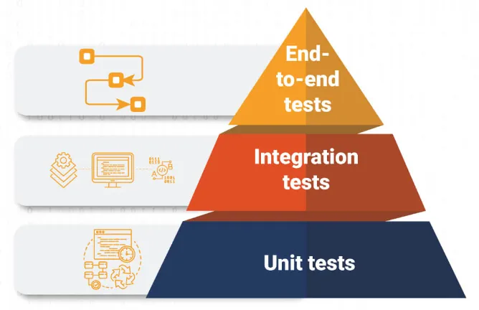
Introduction
Unit Tests vs Integration Tests vs E2E Tests

Slide 20
Introduction
Unit Tests vs Integration Tests vs E2E Tests
The testing pyramid constitutes three distinct levels. Unit tests are at the bottom level, while integration tests and end-to-end tests make up the middle and the top levels, respectively. You should have a lot of unit tests, some integration tests, and very few end-to-end tests in comparison to the other types

Slide 21
Introduction
Unit Test vs. Integration Test in React.js
Feature | Unit Test | Integration Test
Definition | Tests a small, isolated unit (e.g., a single function or component). | Tests multiple units working together (e.g., components interacting with APIs or Redux state).
Scope | Very narrow (single component or function). | Broader, covering multiple components or modules.
Dependencies | Mocked dependencies (e.g., API calls, database). | Uses real or mock APIs, databases, and stores.
Example | Testing a function or component or a hook alone | Testing form submission and API response handling.

Slide 22
II. Tools and Dependencies

Slide 23

Tools and Dependencies
Jest
Jest is a delightful JavaScript Testing Framework with a focus on simplicity.
It works with projects using: Babel, TypeScript, Node, React, Angular, Vue and more!

Slide 24
Tools and Dependencies
Jest
Zero config
Jest aims to work out of the box, config free, on most JavaScript projects.
Fast and safe
By ensuring your tests have unique global state, Jest can reliably run tests in parallel. To make things quick, Jest runs previously failed tests first and re-organizes runs based on how long test files take.

Slide 25

Tools and Dependencies
Testing Library
Introduction
Is a light-weight solution for testing web pages by querying and interacting with DOM nodes (whether simulated with JSDOM/Jest or in the browser)
Helps you test React components in a way that's closer to how users interact with them.

Slide 26
Tools and Dependencies
Installing Dependencies
npm install --save-dev jest @testing-library/react @testing-library/jest-dom or yarn add --dev jest @testing-library/react @testing-library/jest-dom

Slide 27

Tools and Dependencies
Cypress
Introduction
Watch your end-to-end and component tests run in real time as you develop your applications.

Slide 28
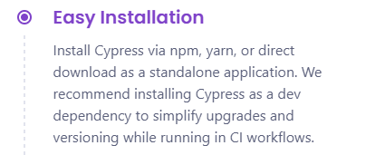
Tools and Dependencies
Cypress
Installing Cypress
npm install --save-dev cypress or yarn add --dev cypress

Slide 29
Tools and Dependencies
Cypress
Running Cypress
{ "scripts": { "cypress:open": "cypress open" } }

Slide 30
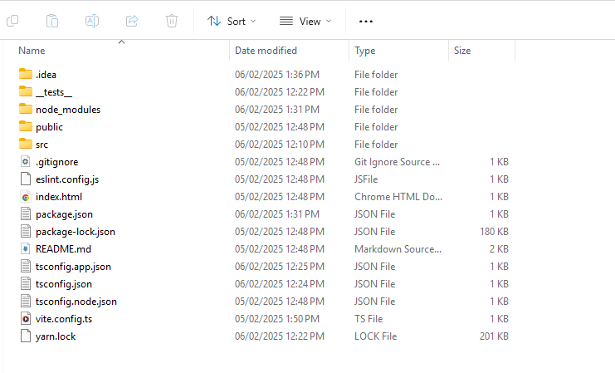
Tools and Dependencies
Cypress
Before Running Cypress

Slide 31
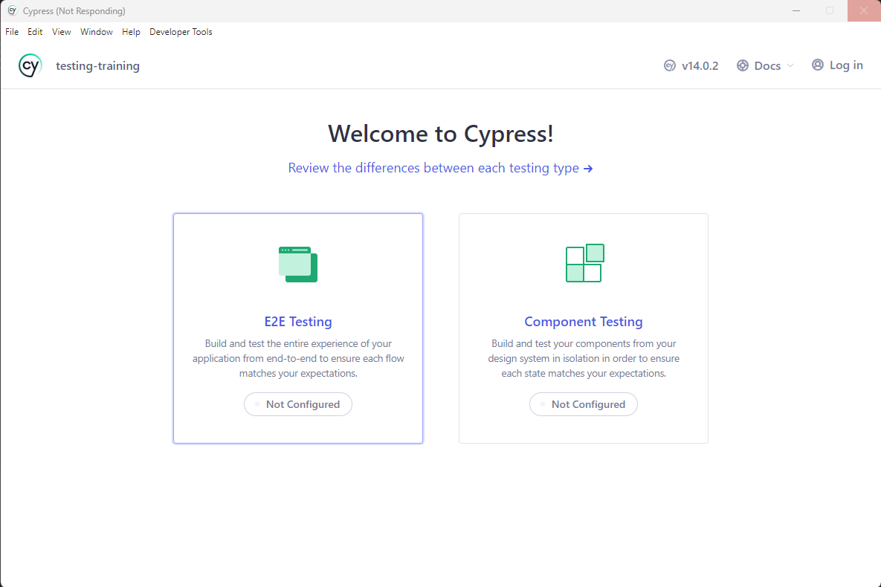
Tools and Dependencies
Cypress
After Running Cypress

Slide 32
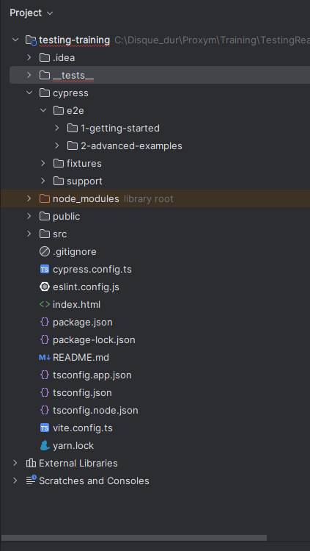
Tools and Dependencies
Cypress
After Running Cypress

Slide 33
III. Unit Testing

Slide 34
Unit Testing
Definition
Unit tests focus on one small part of your app at a time. They make sure that each little bit (like a button or a message) works right on its own.

Slide 35
IV. Integration Testing

Slide 36
Integration Tests
Definition
Integration tests look at how different parts of your app work together. They're about making sure that when you put several parts together, they still work right.

Slide 37
Integration Tests
Code Coverage
Jest comes with built-in code coverage tools that help you understand how much of your codebase is covered by tests. This feature aids in identifying untested areas and improving overall code quality.

Slide 38
Integration Tests
Debugging
import {prettyDOM} from '@testing-library/dom’
const div = document.createElement('div’)
div.innerHTML = '<div><h1>Hello World</h1></div>’
console.log(div)

Slide 39
Integration Tests
Debugging
import {prettyDOM} from '@testing-library/dom’
const div = document.createElement('div’)
div.innerHTML = '<div><h1>Hello World</h1></div>’
console.log(prettyDOM(div))
// <div>
// <h1>Hello World</h1>
// </div>

Slide 40
Integration Tests
Debugging
const div = document.createElement('div’)
div.innerHTML = '<div><h1>Hello World</h1></div>’
// debug document
screen.debug()
// debug single element
screen.debug(div)

Slide 41
V. End-to-End Testing

Slide 42
End-to-End Testing
Definition
End-to-end tests are like pretending you're a user and walking through everything they would do. It's about making sure the whole app works from start to finish, just like it should for a real user.

Slide 43
I. Type of tests

Slide 44




Type of tests
Functional testing
Unit test
Integration test
System
test
Acceptance
test

Slide 45




Type of tests
Non-Functional testing
Security test
Performance test
Usability
test
Compatibility
test

Slide 46


II. Unit & Integration Testing

Slide 47

Unit Testing
A unit test is a way of testing a unit - the smallest piece of code that can be logically isolated in a system. In most programming languages, that is a function, a subroutine, a method or property. The isolated part of the definition is important

Slide 48
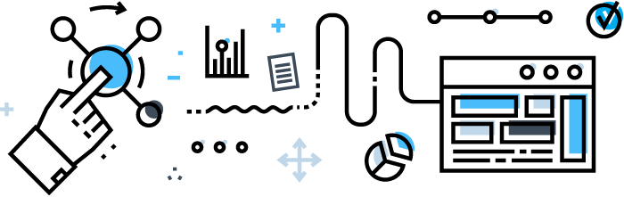
Integration Testing
Integration Testing is defined as a type of testing where software modules are integrated logically and tested as a group. A typical software project consists of multiple software modules, coded by different programmers. The purpose of this level of testing is to expose defects in the interaction between these software modules when they are integrated

Slide 49
Unit vs Integration
Unit Testing | Integration Testing
In unit testing each module of the software is tested separately. | In integration testing all modules of the software are tested combined.
In unit testing tester knows the internal design of the software. | In integration testing doesn’t know the internal design of the software.
Unit testing is performed first of all testing processes. | Integration testing is performed after unit testing and before system testing.
Unit testing is a white box testing. | Integration testing is a black box testing.
Unit testing is basically performed by the developer. | Integration testing is performed by the tester.
Detection of defects in unit testing is easy. | Detection of defects in integration testing is difficult.
It tests parts of the project without waiting for others to be completed. | It tests only after the completion of all parts.
Unit testing is less costly. | Integration testing is more costly.

Slide 50



Question...

Slide 51

III. Tools

Slide 52

JUnit
JUnit is one of the most popular unit-testing frameworks in the Java ecosystem
JUnit Platform
JUnit Jupiter
JUnit vintage

Slide 53
JUnit
JUnit Platform
JVM
TESTS
TESTS
TESTS
TESTS

Slide 54
JUnit
Annotations
JUnit Jupiter
@TestFactory
@DisplayName
@Tag
@ExtendWith
@BeforeEach
@AfterEach
@BeforeAll
@AfterAll
@Disable
@Sql

Slide 55
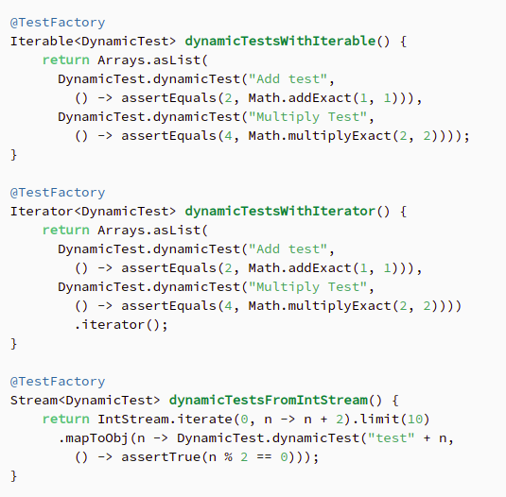
JUnit Jupiter
@TestFactory

Slide 56
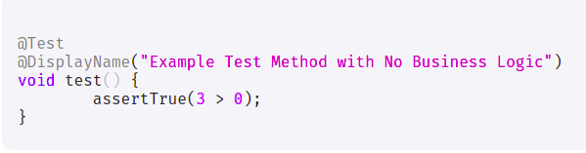
JUnit Jupiter
@DisplayName

Slide 57
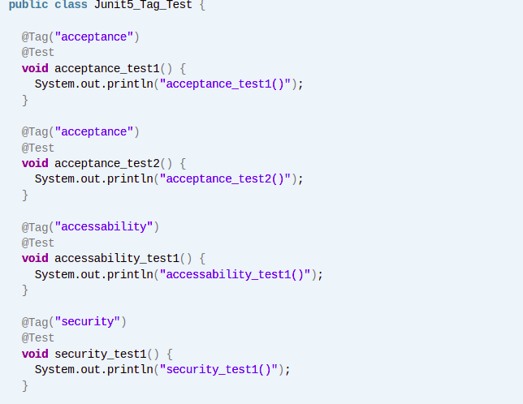
JUnit Jupiter
@Tag
# Run tests which tagged with `load` and exclude tagged with `api` mvn test -Dgroups="load" -DexcludedGroups="api" # Run tests which tagged with `api` or `performance` mvn test -Dgroups="api | performance" # Run tests which tagged both `api` and `performance` mvn test -Dgroups="api & performance"

Slide 58
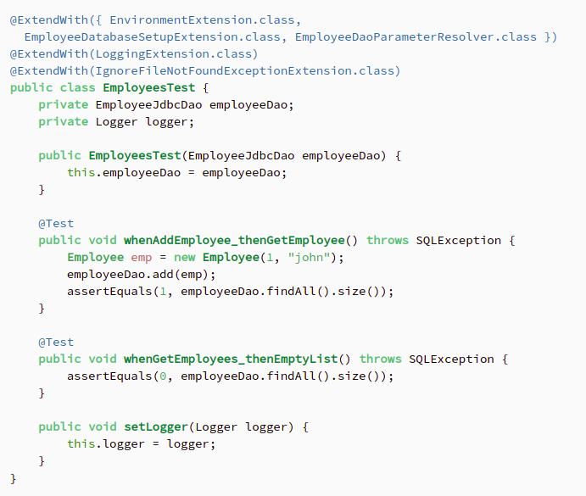
JUnit Jupiter
@ExtendWith

Slide 59
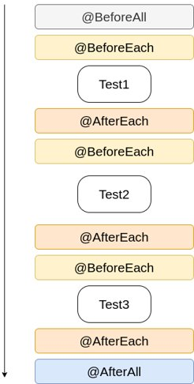
JUnit Jupiter
@BeforeEach
@AfterEach
@BeforeAll
@AfterAll

Slide 60
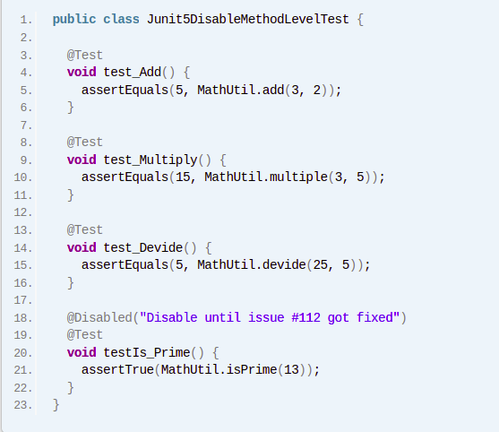
JUnit Jupiter
@Disabled

Slide 61
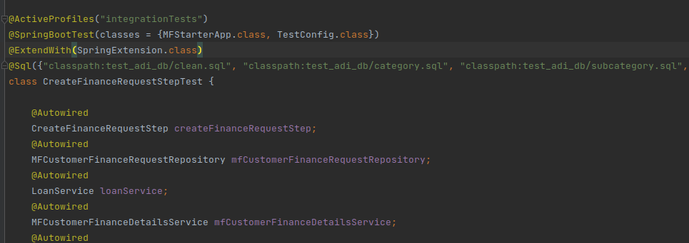
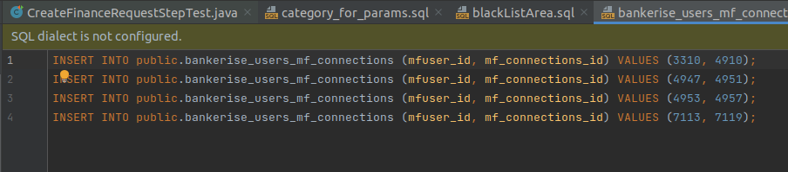
JUnit Jupiter
@Sql

Slide 62
JUnit Jupiter
@ActiveProfiles

Slide 63
JUnit Jupiter
@SpringBootTest

Slide 64
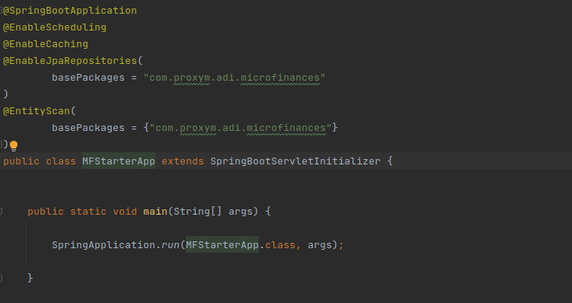
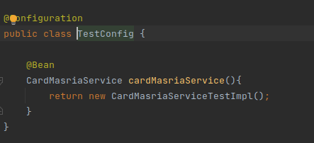
JUnit Jupiter
@SpringBootTest

Slide 65

JUnit
TESTS
TESTS
TESTS
JUnit vintage
JVM
TESTS
4
3

Slide 66
IV. Mocking

Slide 67
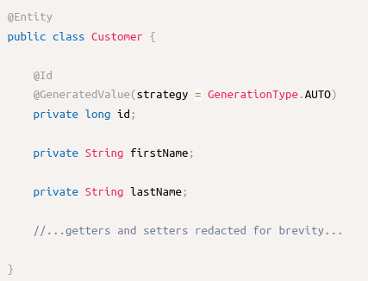
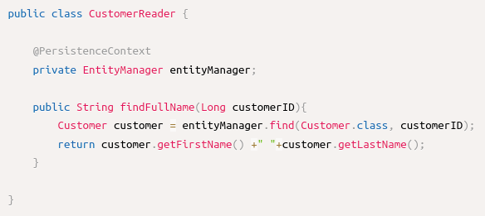
Mocking (Mockito)

Slide 68
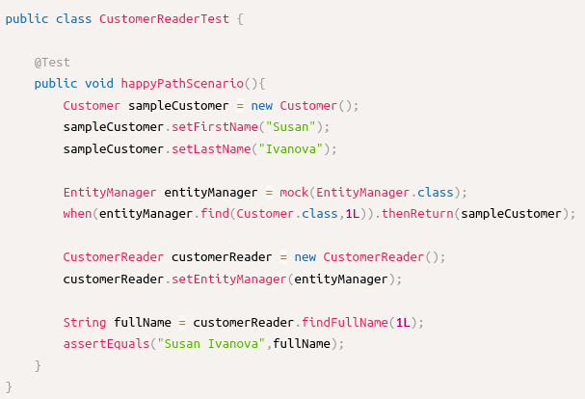
Mocking (Mockito)

Slide 69
IV. Start of the workshop

Slide 70
Merci pour votre attention

